Slide 1
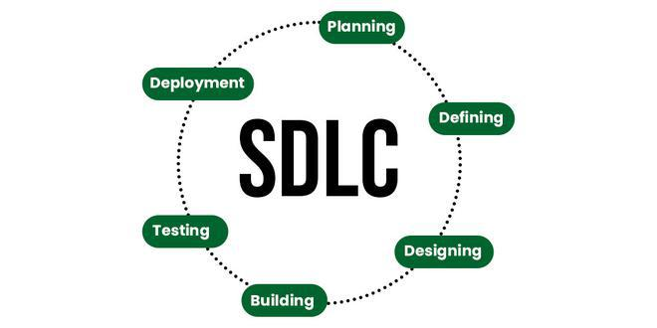
What is the Software Development Life Cycle (SDLC)?
SDLC is a process followed for software building within a software organization.

Slide 2
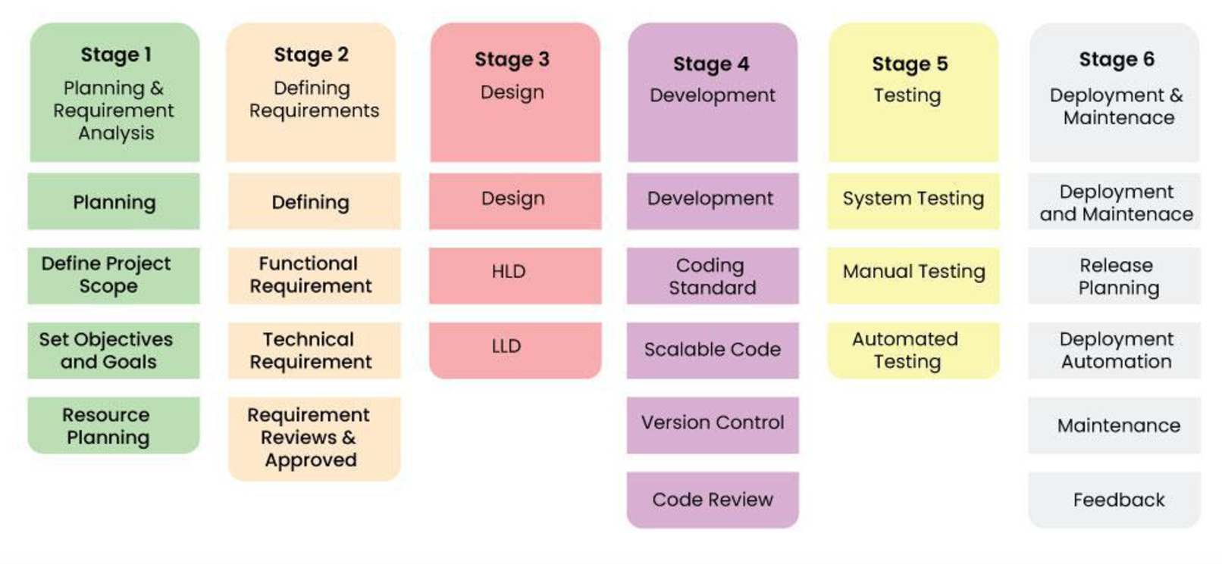

Slide 3
Classical Waterfall Model
Feasibility Study ↓
Requirement Analysis and Specifications ↓
Design ↓
Coding and Unit Testing ↓
System Testing and Integration ↓
Maintenance

Slide 4
Advantages:
Base Model
Simple and Easy
Suitable for Small Projects
Disadvantages:
No Feedback Mechanism
No Experimentation
No Parallelism
High Risk
60% Efforts in Maintenance

Slide 5
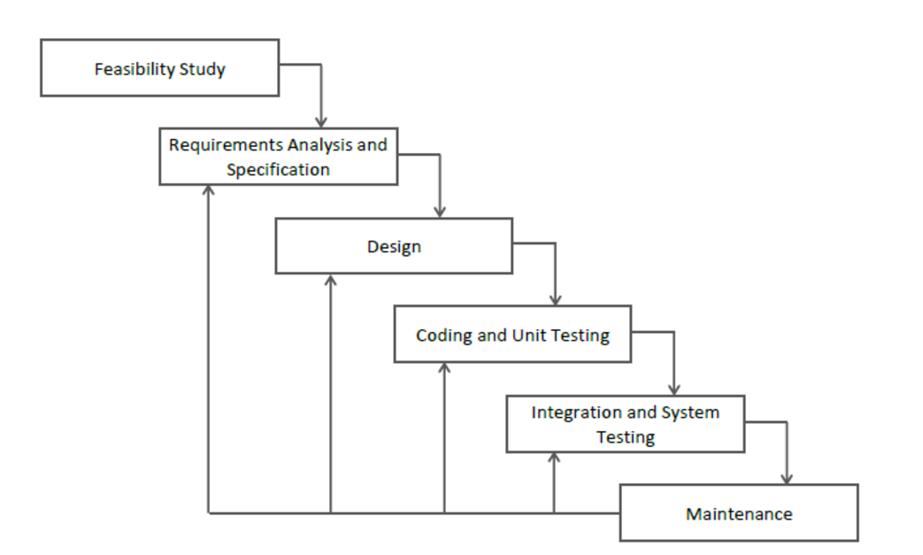
Iterative Waterfall Model

Slide 6
Advantages:
Base Model
Simple and Easy
Suitable for Small Projects
Feedbacks
Disadvantages:
No Phase Overlapping
No Intermediate Delivery
Rigid (No Changes Allowed)
Less Customer Interaction

